Slide 1

Presented by Forest Wang Jun Lin
Cohort 47

Slide 2
🧠 Problem Statement
This project aims to design and develop a comprehensive Business Intelligence dashboard that consolidates customer demographics, purchasing behavior, and product sales data. The dashboard will provide management with a holistic view of market trends, customer segmentation, and sales performance empowering the managers to make decisions regarding marketing, inventory, and customer retention strategies.

Slide 3
🎯 Research Objectives
Understand customer demographics and buying patterns
Identify top-spending segments and high-value customers
Evaluate sales trends and product performance across markets
Examine how pricing and discounts influence profitability
Present insights through an interactive Power BI dashboard

Slide 4
🧮 Expected Deliverable
An interactive Power BI dashboard integrating customer, product, and sales data.
Visualizes customer segmentation, sales performance, and discount impact.
Highlights top-performing countries and products driving revenue growth.
Delivers clear, data-backed insights for marketing, pricing, and retention decisions.
Notes:
This dashboard provides a single interactive view of all key business metrics — from customer profiles to product sales and discount performance.
It enables decision-makers to identify growth drivers, evaluate profitability across regions, and optimize pricing and marketing strategies.
Each visualization was designed to provide clarity and actionable insights, aligning directly with the project objectives.

Slide 5
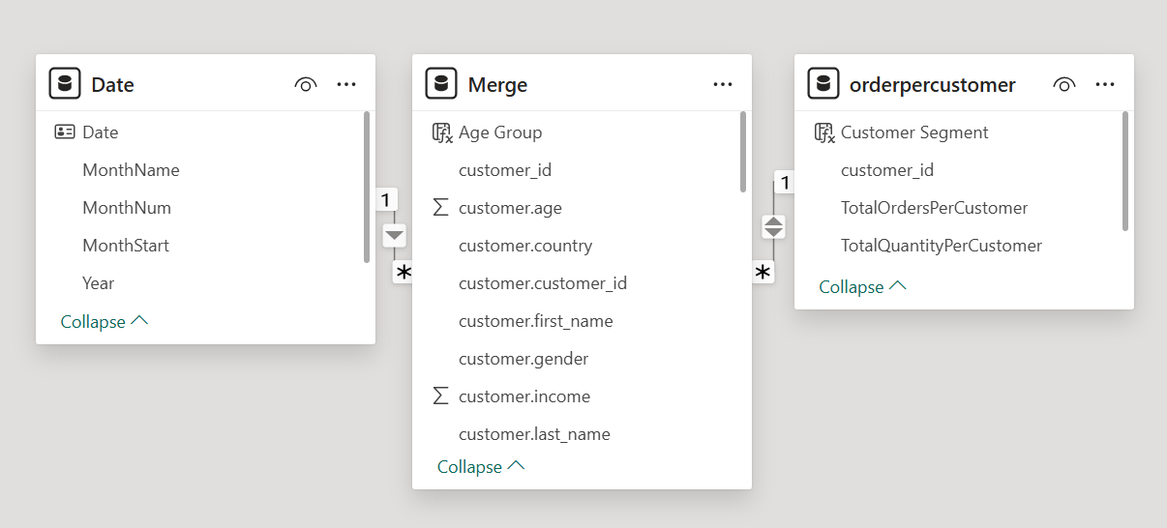
🧮 Methodology to study
Combined customer, and purchase data into one merged dataset for a full business view.
Performed data cleaning and standardized formats to ensure accuracy.
Created a customer segmentation table using order frequency and spend levels (cut-offs at 20K / 30K).
Built relationships between merged, date, and customer tables to support time-series and segment analysis.
Notes:
The study began by integrating all key datasets — purchase and customer — into one reliable model.
Data was cleaned and standardized to maintain consistency and avoid duplication.
Customers were then segmented into low, mid, and high-value groups based on total spend and order frequency.
Finally, relationships between the merge, date, and orderpercustomer tables enabled time-based and behavioural insights across the dashboard.

Slide 6
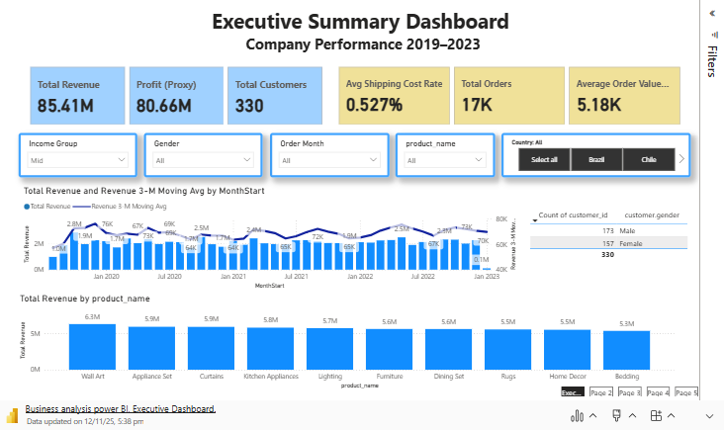
Notes:
If a manager wants to plan a campaign in Colombia. She can simply select 'Colombia’ at slicer. Instantly, the dashboard updates to show her the top-selling products, similarly, by multi select order months, she will notice the order pattern across the year.
This Power BI can be scalable so that when new sales data comes in each month, you just click the 'Refresh' button and the entire dashboard will update accordingly. It's designed to stay relevant and useful for years to come
we notice that high income group has the highest average order value, where low income group customer has higher average order value than the mid income group

Slide 7
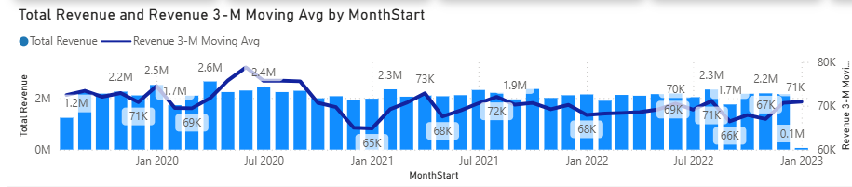
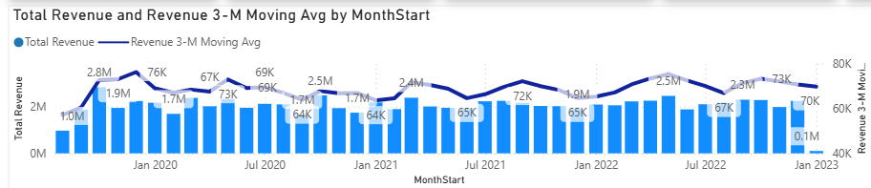
🧮 Insight from Executive Summary
Revenue grew steadily from 2020–2023 with strong Q4 peaks (Oct–Dec).
Profit margins stable; shipping cost efficiency improved to 0.52%.
Home & Décor drives sales; Colombia and Chile contribute >50% of total revenue.
AOV pattern of High > Low > Mid
Low-income customers likely place fewer orders and buy more per order, Peaks line up with promotional cycles
Mid-income customers usually have more frequent, smaller baskets with mild seasonality
Low income group
Mid income group
Notes:
This chart highlights a clear revenue growth pattern with recurring Q4 peaks, reflecting seasonal buying behavior.
Low-income (1st chart): revenue shows deeper troughs and sharper peaks (bigger amplitude). That pattern typically means infrequent purchases batched into bigger orders (e.g., promo months, bundle buys).
Mid-income (2nd chart): revenue is steady month-to-month with mild seasonality. This pattern usually comes from more frequent, smaller baskets.

Slide 8
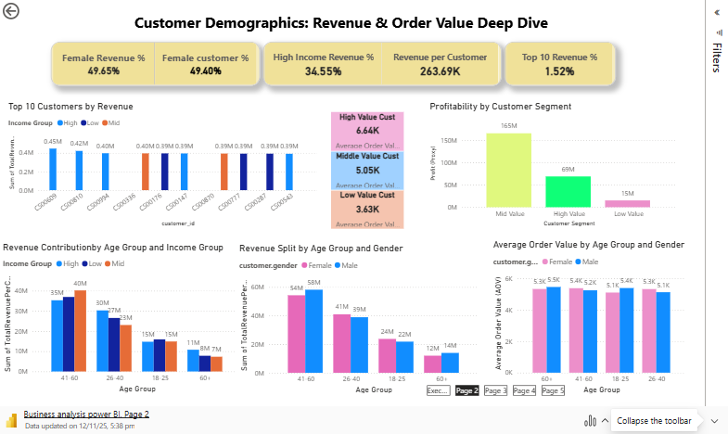
Notes:
The mid-value customer segment consistently delivers the highest profitability, regardless of income group.
Focusing efforts on mid-value customers can yield the greatest return for the business.
Suggest prioritizing engagement and retention strategies for this segment to maximize overall company profit.
Evaluate why mid-value customers are more profitable and find ways to replicate their behaviors across other segments.
Avoid allocating excessive resources to high- or low-value segments; balance strategy to support mid-value growth.

Slide 9
🧮 Customer Demographics & Spending Behaviour
41–60 age group contributes the highest revenue share
The mid-value customer segment consistently delivers the highest profitability, regardless of income group.
Gender split ~50/50; males show slightly higher average spend.
High-income customers generate ~35% of total sales.
Top 10 customers contribute only ~1.5% of sales — low revenue concentration risk.
Notes:
This analysis highlights that our most valuable customers are aged 41–60, a mature segment with strong purchasing power. This directly answers our objective to analyze how demographics impact spending. We now know our marketing should strongly target this age group.
The near-equal gender split shows balanced engagement across audiences, though male customers tend to spend slightly more per transaction.
High-income customers account for over one-third of revenue, emphasizing the need to sustain premium positioning.
With our top 10 customers contributing only about 1.5% of sales, the business shows healthy diversification and low dependency on individual buyers.

Slide 10
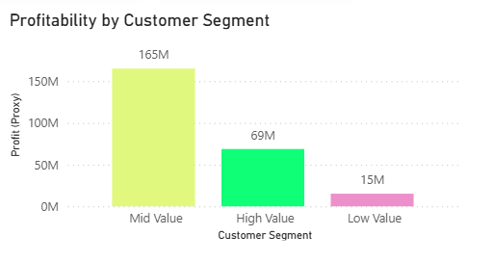
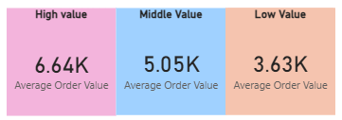
🧮 Customer Segmentation & Profitability Analysis
• Mid-Value customers generate the highest total profit (~165 M).
• High-Value customers show strong profitability (69 M) with high retention potential.
• Low-Value customers contribute minimal profit (15 M).
• AOV difference: High 6.64 K | Mid 5.05 K | Low 3.63 K.
Notes:
This segmentation shows that mid-value customers drive the bulk of total profit, making them a key revenue anchor.
High-value customers, though smaller in number, generate strong margins and present excellent retention and cross-sell opportunities.
Low-value customers add volume but limited profit, suggesting they’re less strategic for targeted campaigns.
The AOV gap between high and low-value customers highlights clear potential for upselling and personalized engagement to lift mid-tier spending.

Slide 11
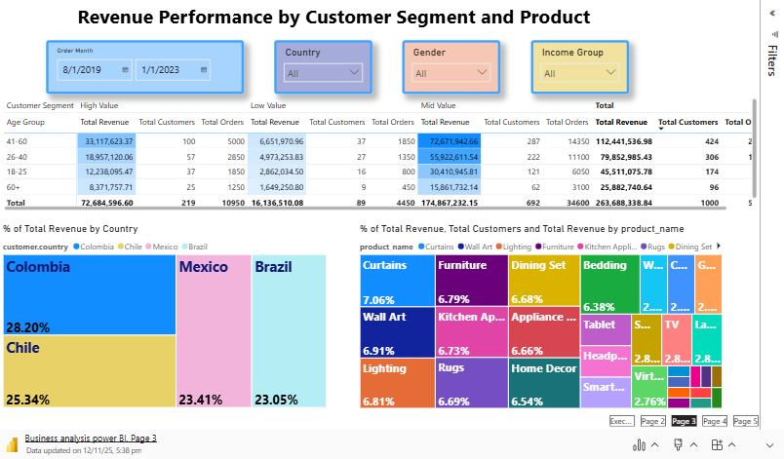
Notes:
This dashboard is fully interactive, allowing users to filter by period, country, income group, or gender to instantly view total revenue and the corresponding product preferences.
When hovering over a treemap segment, you can see both the percentage and absolute revenue contribution for each country on the right, while the left-hand treemap displays product-level details.
Changing the income group filter reveals distinct purchasing patterns, which can be used to design targeted product bundles—especially during key shopping periods such as Christmas.
The Power BI model is built for sustainability; with each new month’s data, a single refresh automatically updates all visuals, ensuring the dashboard remains current and actionable over time.

Slide 12
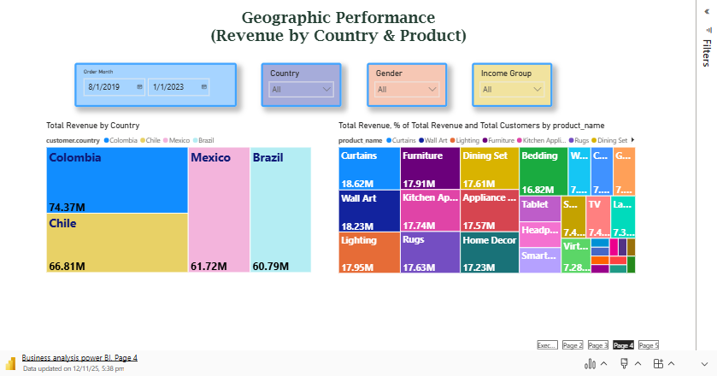
🧮 Geographic Performance
(Revenue by Country & Product Interaction)
Colombia (74 M) and Chile (67 M) remain key markets, contributing over 50 % of total revenue.
Home & Décor products — Curtains, Wall Art, Furniture, Lighting — together drive nearly two-thirds of sales.
Mid-Value customers deliver the largest share of revenue through steady order volumes.
41–60 age group stands out as the most profitable and loyal segment
Notes:
Colombia and Chile continue to be our strongest markets, together generating more than half of total revenue.
Marketing and supply-chain strategies should prioritize these two countries to support sustainable growth.
Within the product mix, Home & Décor categories — especially Curtains, Wall Art, Furniture, and Lighting — are consistent top performers, so inventory and promotion planning should focus here.
Lastly, maintaining engagement with Mid-Value customers and the 41–60 age segment will be crucial for retention and upselling, as these groups provide the highest recurring revenue.

Slide 13
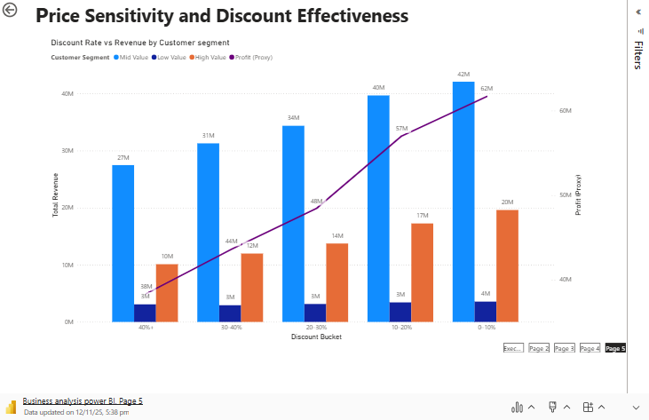
Revenue increases steadily as discounts rise up to 30 %, showing moderate price sensitivity.
Profit peaks between 0 – 20 % discount range — the optimal “sweet spot.”
Beyond 30 %, profit declines sharply, indicating over-discounting hurts margins.
Discounts over 40 % may lift sales volume but erode profitability significantly.
Notes:
This slide examines the impact of discount levels on both revenue and profit.
The blue columns represent total revenue, while the purple line tracks profit performance.
As we can see, revenue rises gradually with discounts up to about 30 %, indicating moderate customer price sensitivity.
once discounts exceed 30 %, profit starts to drop sharply — proving that deeper discounts do more harm than good.
The optimal range is between 10 - 20 %, where both revenue and profit remain balanced.
Therefore, our key recommendation is to maintain discounts within this range and instruct the sales team to avoid offering discounts above 30 % to protect margins.

Slide 14
🧮 Overall Summary
Total revenue: S$263.7M, led by Mid-Value customers (largest profit pool).
Markets: Colombia (~74M) and Chile (~67M) together deliver >50% of sales; both show stable demand.
Product mix: Home & Décor (curtains, wall art, furniture, lighting) is the core revenue engine.
Discount behavior: Revenue increases as discounts rise, but profit is strongest in the 10–30% band.
Seasonality: Strong Q4 peaks (Oct–Dec) → need capacity and stock readiness.
Customer structure: High-Value segment is smaller but profitable; Mid-Value is broad and repeat-driven.
Notes:
This final slide summarizes the key insights and recommended actions from the analysis.
Overall revenue reached 263 million, mainly driven by Mid-Value segments, which form the core of long-term profitability.
Colombia and Chile lead in sales, together contributing more than half of total revenue, while Home & Décor remains the best-performing category.
Pricing analysis shows that maintaining discounts between 10 % to 30 % maximizes both sales and margins.
Based on these findings, the key priorities are to retain high-value customers through loyalty initiatives, upsell mid-value buyers via curated bundles, and strengthen digital engagement with younger audiences.
Finally, reinforcing stock and staffing ahead of Q4 and replicating the success strategies from Colombia and Chile in emerging markets will ensure sustained growth and stronger profitability going forward.

Slide 15
🧮 Strategic Actions & Next Steps
1. Protect & grow core customers
Retain High-Value customers through loyalty and personalization.
Upsell Mid-Value customers via bundle promotions.
Target 41–60 age group with higher-ticket décor sets.
Expand digital targeting to younger segments.
2. Optimize discount & margin
  Cap promos >30% to selected SKUs only.
  Run monthly discount effectiveness report from Power BI.
3. Operational readiness for Q4 & expansion
  Apply Colombia & Chile best practices to new markets.
  Pre-stock Colombia & Chile SKUs before Q4.
  Monitor shipping cost rate to keep it at current level.
Notes:
Keep the customers that already pay us, don’t give away margin, and make sure ops is ready before Q4. Colombia and Chile are the blueprint.”

